Slide 1
Image Style Transfer via Convolutional Neural Network
Computer Science Department
Shang Da

Slide 2
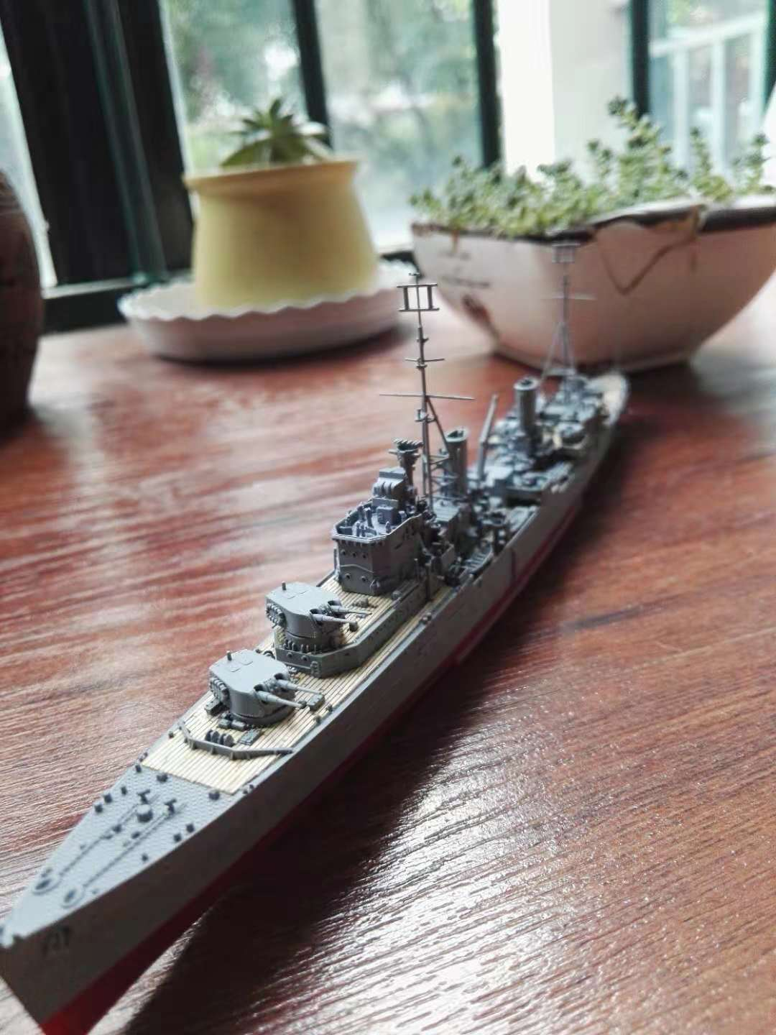
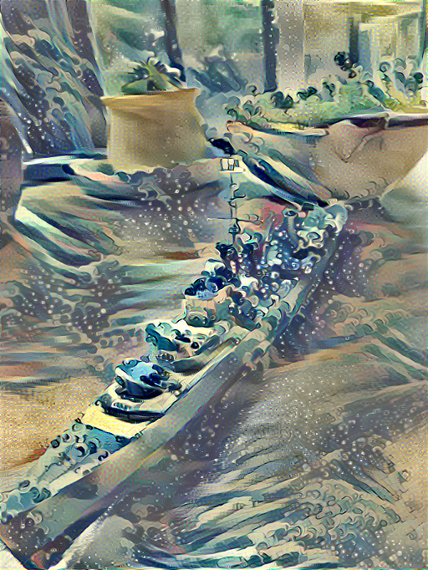
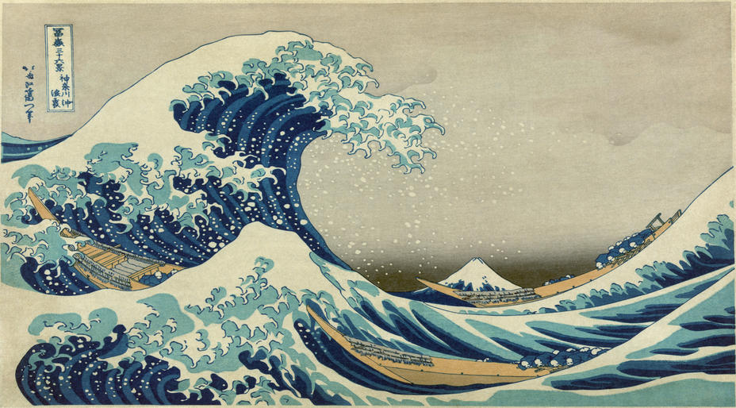
Our goal
Given a style reference image and a content image, generate a new image that “applies” the style to original content image.
+
=

Slide 3
Key Idea
Style and Content are both features. We extract these features, then define some measurement(loss function) based on these features. Then we generate result by minimizing the loss function.

Slide 4
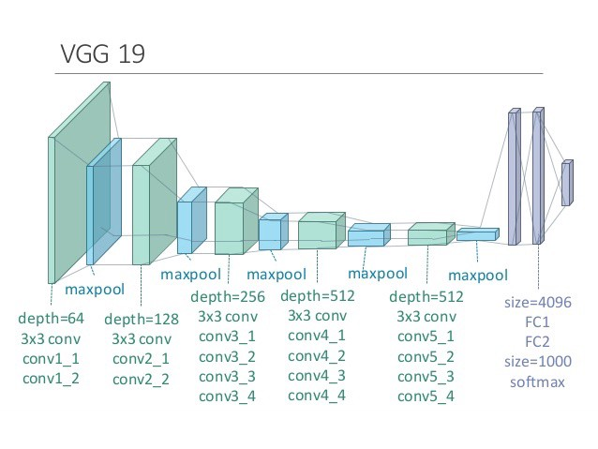
Pretrained VGG-19 network
VGG-19 a very deep neural network structure originally designed for image classification. It consists of sixteen convolutional layers and 3 fully connected layers. The convolutional layers are used for feature extraction and fully connected layers are used for classification.
Weights are from here:
http://www.vlfeat.org/matconvnet/models/beta16/imagenet-vgg-verydeep-19.mat

Slide 5
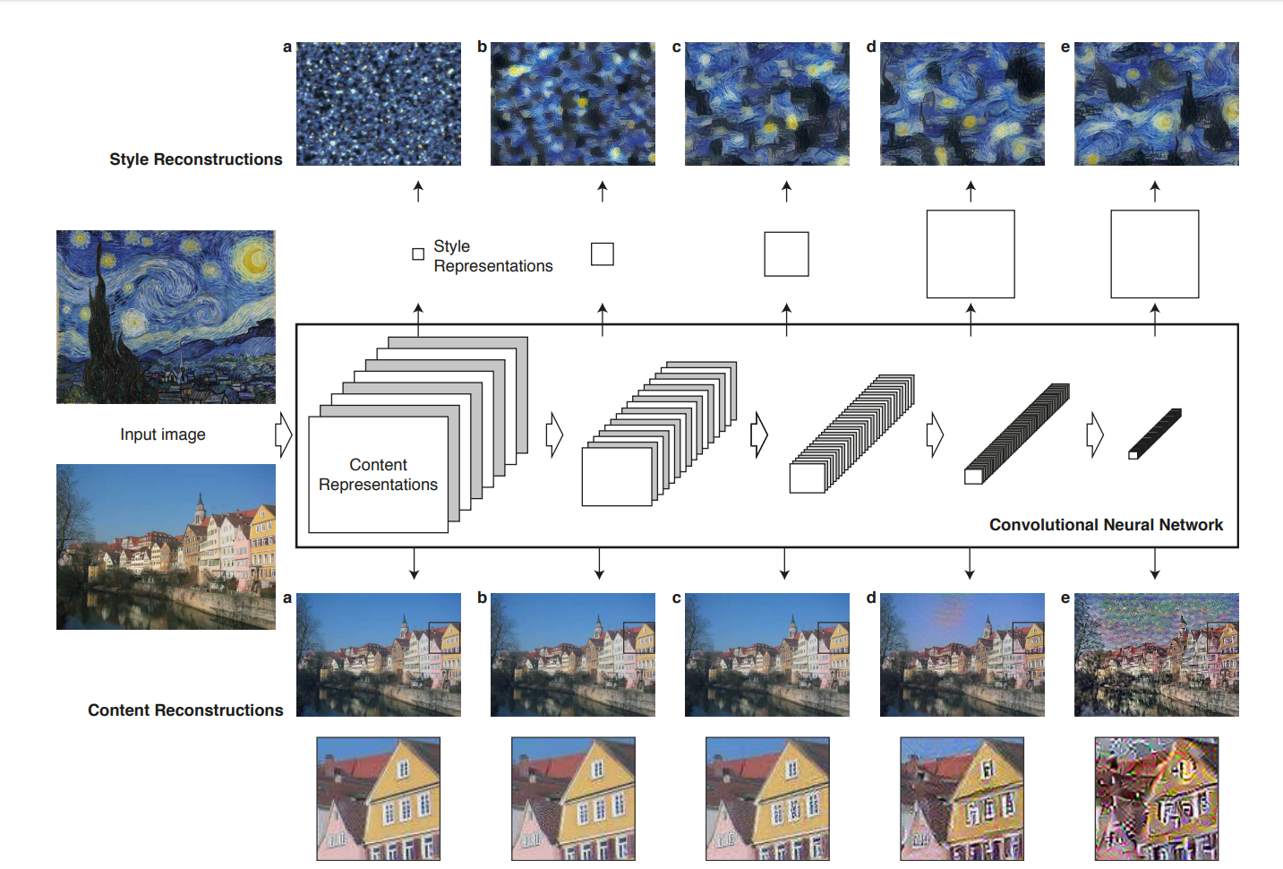
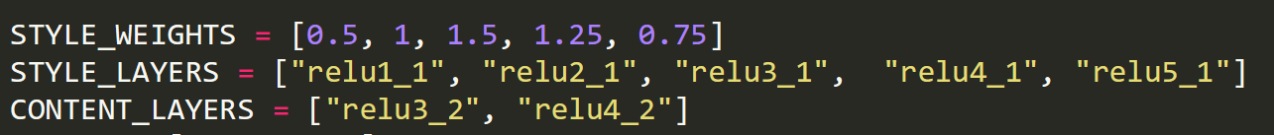
Style Features and Content Features
Style Features：From every layers.
Content features: From higher layers.

Slide 6
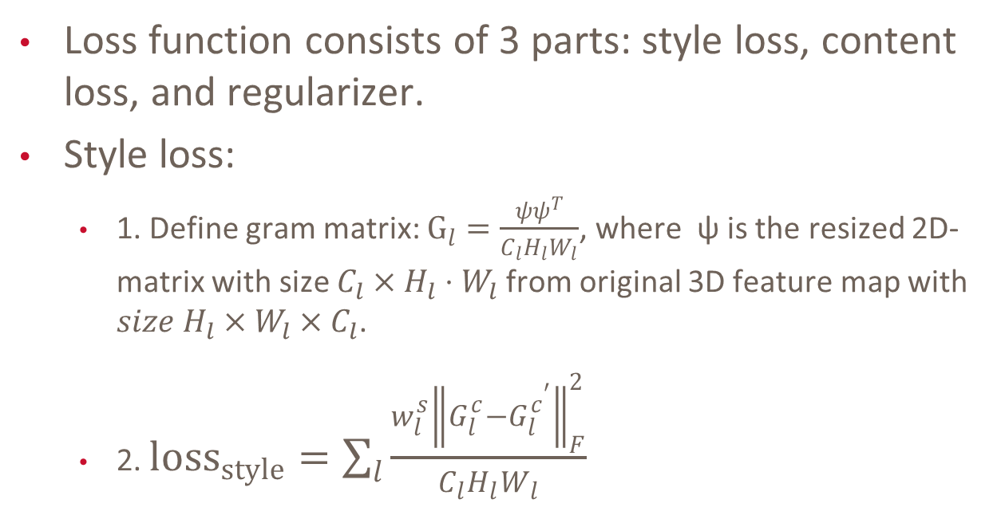
Loss function
Loss function consists of 3 parts: style loss, content loss, and regularizer.
Style loss:
1. Define gram matrix: $G_{l}=\frac{ψψ^{T}}{C_{l}H_{l}W_{l}}$, where ψ is the resized 2D-matrix with size $C_{l}×H_{l}⋅W_{l}$from original 3D feature map with $size H_{l}×W_{l}×C_{l}$.
2. $loss_{style}=\sum_{l}{\frac{w_{l}^{s}{\left\|G_{l}^{c}−G_{l}^{c^{′}}\right\|}_{F}^{2}}{C_{l}H_{l}W_{l}}}$

Slide 7
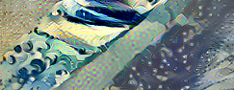
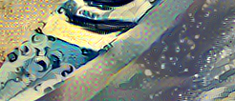
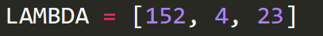
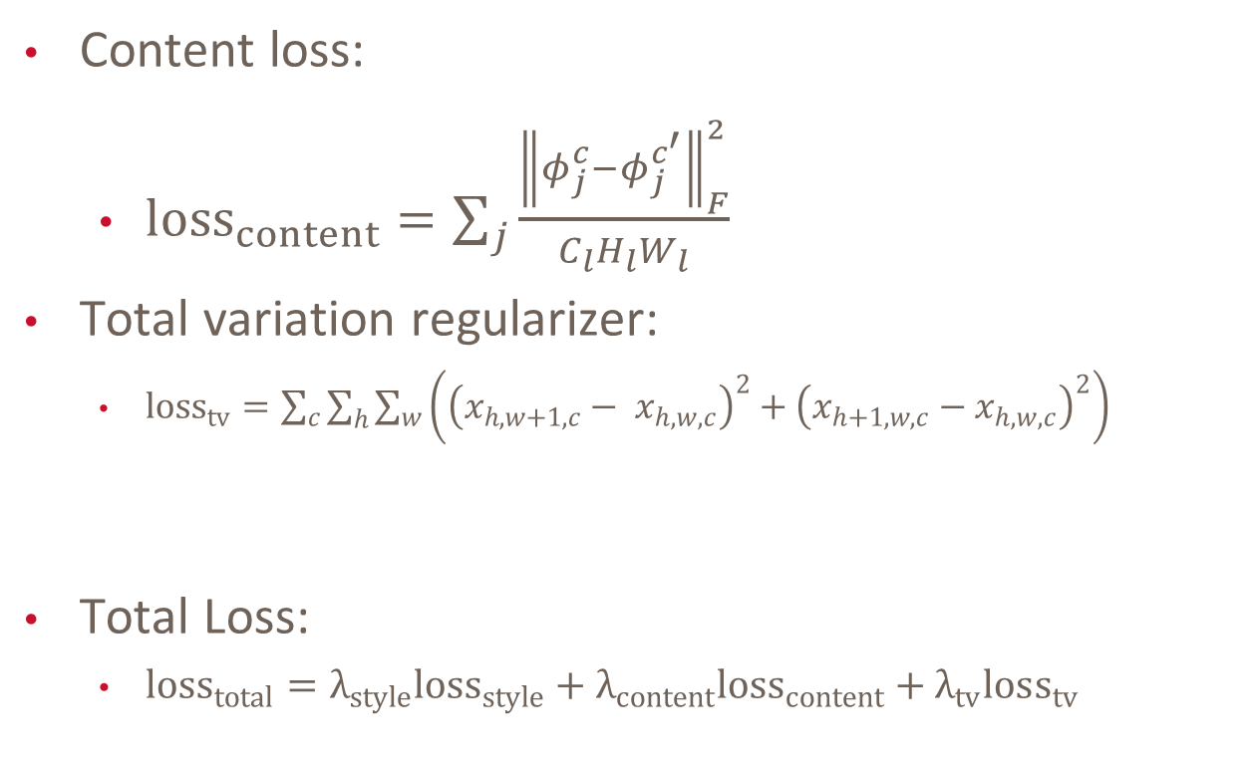
Loss function
Content loss:
${loss}_{content}=\sum_{j}{\frac{{\left\|φ_{j}^{c}−φ_{j}^{c^{′}}\right\|}_{F}^{2}}{C_{l}H_{l}W_{l}}}$
Total variation regularizer:
${loss}_{tv}=\sum_{c}{\sum_{h}{\sum_{w}{\left({\left(x_{h,w+1,c}− x_{h,w,c}\right)}^{2}+{\left(x_{h+1,w,c}−x_{h,w,c}\right)}^{2}\right)}}}$
Total Loss:
${loss}_{total}=λ_{style}loss_{style}+λ_{content}{loss}_{content}+λ_{tv}loss_{tv}$

Slide 8
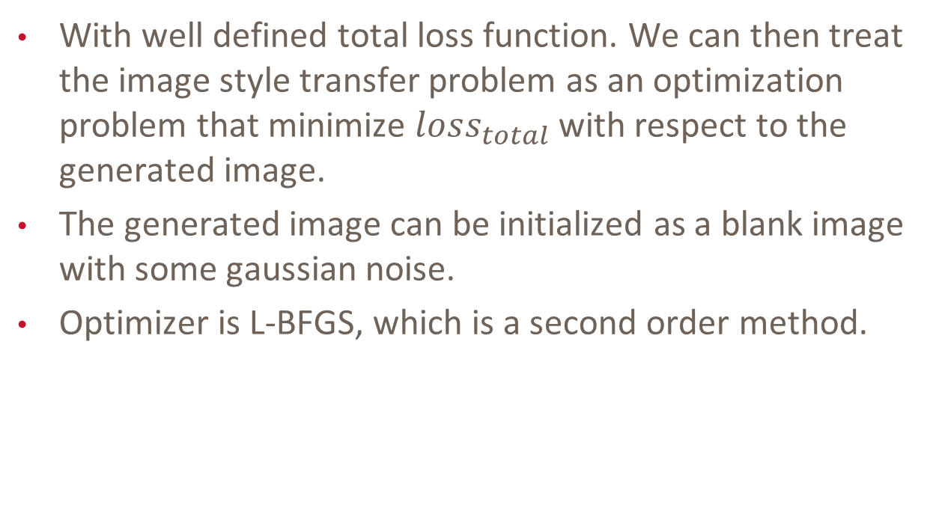
Generation
With well defined total loss function. We can then treat the image style transfer problem as an optimization problem that minimize $loss_{total}$with respect to the generated image.
The generated image can be initialized as a blank image with some gaussian noise.
Optimizer is L-BFGS, which is a second order method.

Slide 9



Slide 10
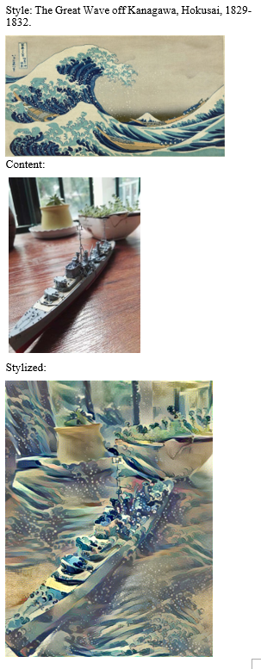
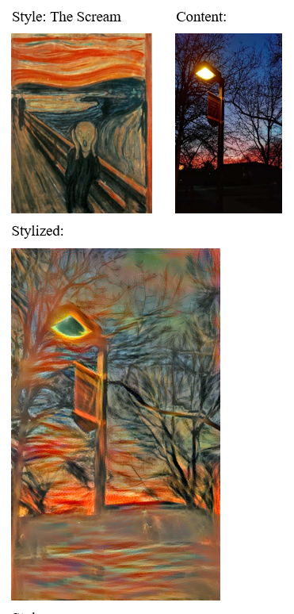
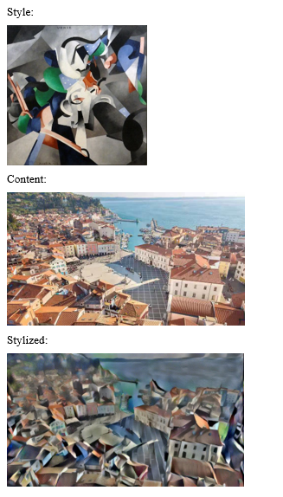
Results:

Slide 11
Future works:
Generative network approach.

